Slide 1
The Partnership for a Healthy Delaware County
November 7, 2018

Slide 2
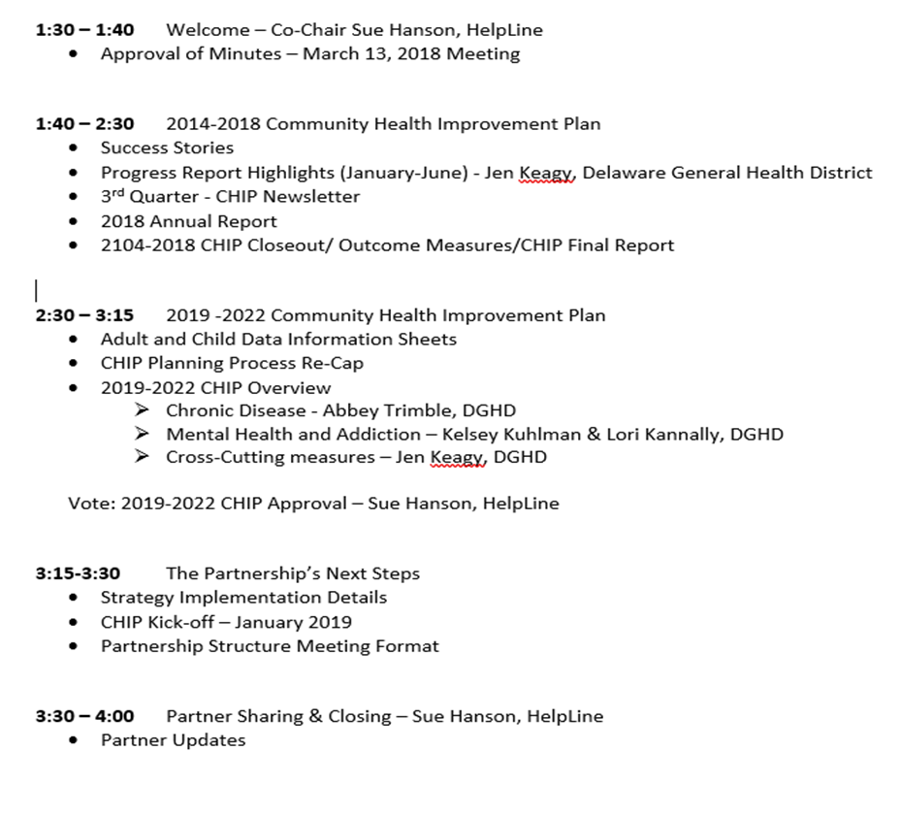
Agenda

Slide 3
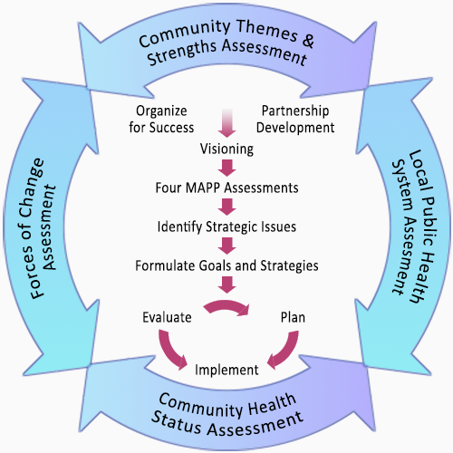
MAPP Process

Slide 4
2014-2018 Community Health Improvement Plan

Slide 5
Current CHIP
Success Stories
Progress Report
Q3 Newsletter
2018 Annual Report
2014-2018 CHIP Final Report

Slide 6
2019-2022 Community Health Improvement Plan

Slide 8
Report Key
Throughout the report, hyperlinks will be highlighted in bold, gold text. If using a hard copy of this report, please see Appendix I for links to websites.
This symbol will be used throughout the report when a strategy has been rated by What Works for Health as “likely to decrease disparities” and/or recommended by the Community Guide as effective strategies for achieving health equity.

Slide 9
Report Key
This symbol will be used throughout the report when a priority, indicator, or strategy directly aligns with the 2017-2019 SHIP.
State Requirements (at minimum):
2 priority topics
1 priority outcome indicator for each priority
1 cross-cutting strategy/ 1 cross-cutting outcome indicator

Slide 10
2019-2022 Strategies

Slide 11
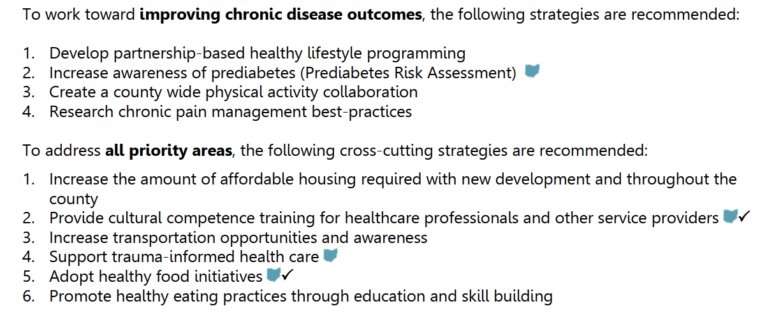
2019-2022 Strategies

Slide 12
Priority Strategy Review

Slide 13
2019-2022 CHIP Motion to Adopt
To adopt the 2019-2022 Delaware County Community Health Improvement Plan [as amended today] in lieu of any recommended edits received from public comment.
(In the event that additional major edits are recommended, the suggestions will be shared via email and an active vote taken via email.)

Slide 14
The Partnership’s Next Steps
Strategy Implementation
CHIP Report Kick-Off – January 2019
Partnership Structure

Slide 15
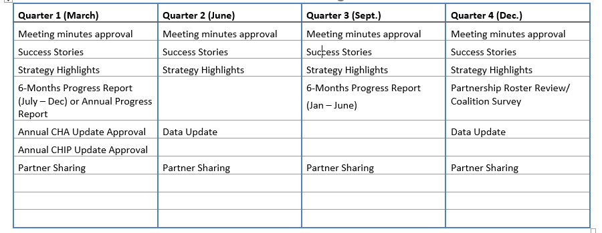
Partnership Meeting Plan (1.5 hr.)

Slide 16
The Partnership Leadership
Members:
Co-Chairs (2)
Priorities & Cross-Cutting Strategies (6)
DGHD Staff (1 Coordinator and 1 staff/priority = 4) Evaluator/Epidemiologist?
Total = 12
Max. of 15

Slide 17
The Partnership Steering Committee
Responsibilities:
Serve as advisory group for the Partnership
Share/ Integrate Data
Create and propose the updated Annual Community Health Assessment (CHA)
Create and propose the updated Community Health Improvement Plan (CHIP) for the upcoming year
Identify gaps and resources
Oversee Partnership Communications
Promote the Partnership’s work
Determine procedural and organizational operations (logistics), Task such as develop policies, steer the CHIP Process, inform the agenda, etc.
Others?

Slide 18
Partnership Sharing

Slide 19
THANK YOU!!! for making Delaware County a community where we work together to provide opportunities for complete health and well-being!

